Slide 1
Neural Nets
Brain Computer Interaction- S2022
Acknowledgements: (berkeley.edu)

Slide 2
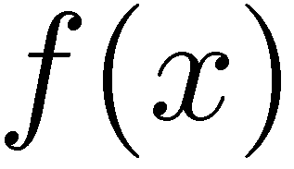

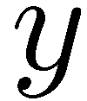

Feature Vectors
Hello,
Do you want free printr cartriges? Why pay more when you can get them ABSOLUTELY FREE! Just
# free : 2
YOUR_NAME : 0
MISSPELLED : 2
FROM_FRIEND : 0
...
SPAM
or
+
PIXEL-7,12 : 1
PIXEL-7,13 : 0
...
NUM_LOOPS : 1
...
“2”

Slide 3
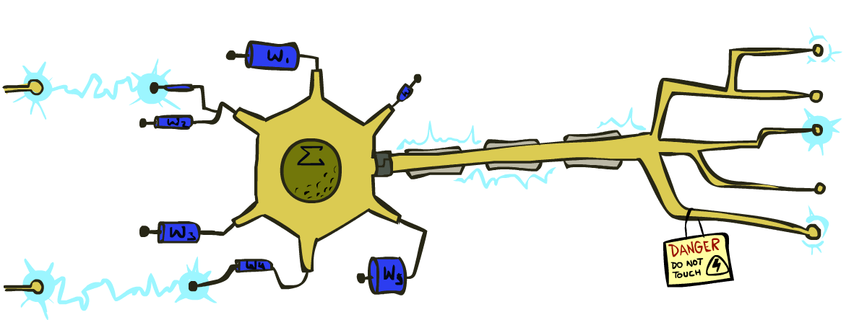
Some (Simplified) Biology
Very loose inspiration: human neurons

Slide 4
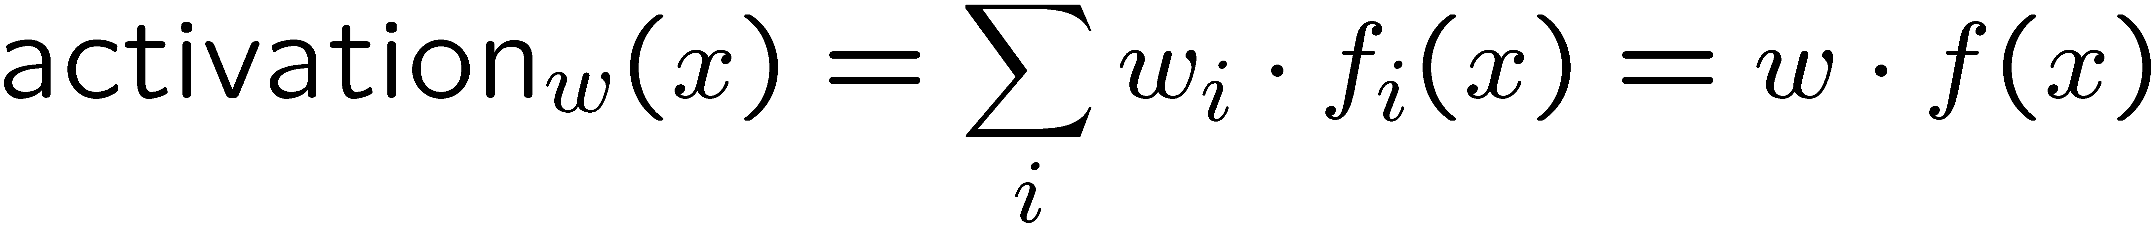
Linear Classifiers
Inputs are feature values
Each feature has a weight
Sum is the activation
If the activation is:
Positive, output +1
Negative, output -1
w₁
f₁
Σ
w₂
>0?
f₂
w₃
f₃

Slide 5


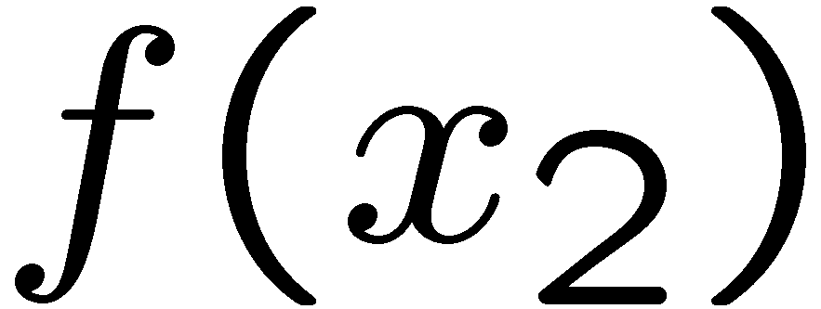
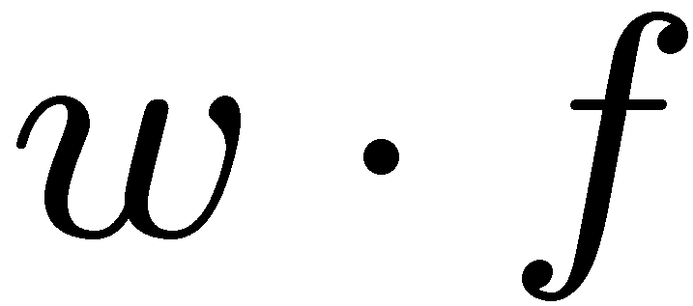
Weights
Binary case: compare features to a weight vector
Learning: figure out the weight vector from examples
# free : 4
YOUR_NAME :-1
MISSPELLED : 1
FROM_FRIEND :-3
...
# free : 2
YOUR_NAME : 0
MISSPELLED : 2
FROM_FRIEND : 0
...
# free : 0
YOUR_NAME : 1
MISSPELLED : 1
FROM_FRIEND : 1
...
Dot product positive means the positive class

Slide 6
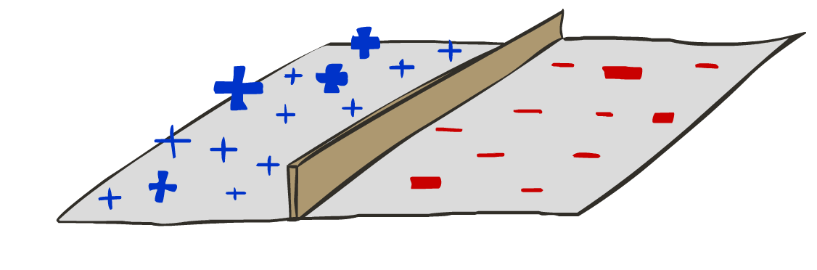

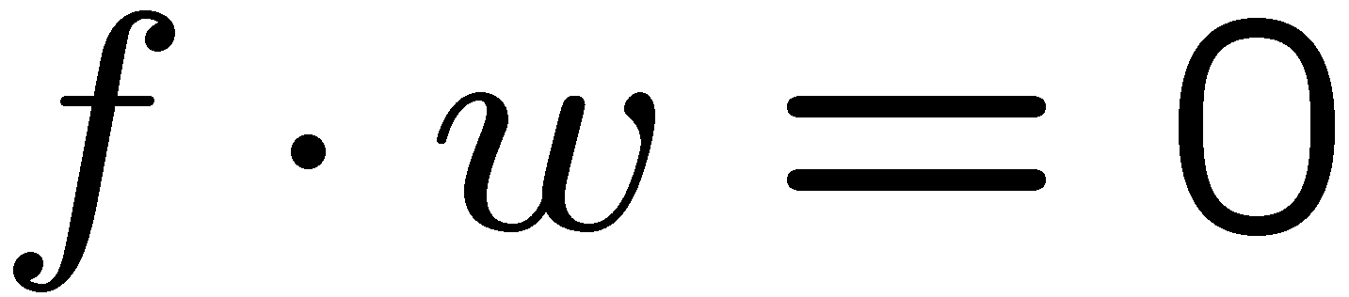
Binary Decision Rule
In the space of feature vectors
Examples are points
Any weight vector is a hyperplane
One side corresponds to Y=+1
Other corresponds to Y=-1
money
2
+1 = SPAM
1
BIAS : -3
free : 4
money : 2
...
0
-1 = HAM
0
1
free

Slide 7
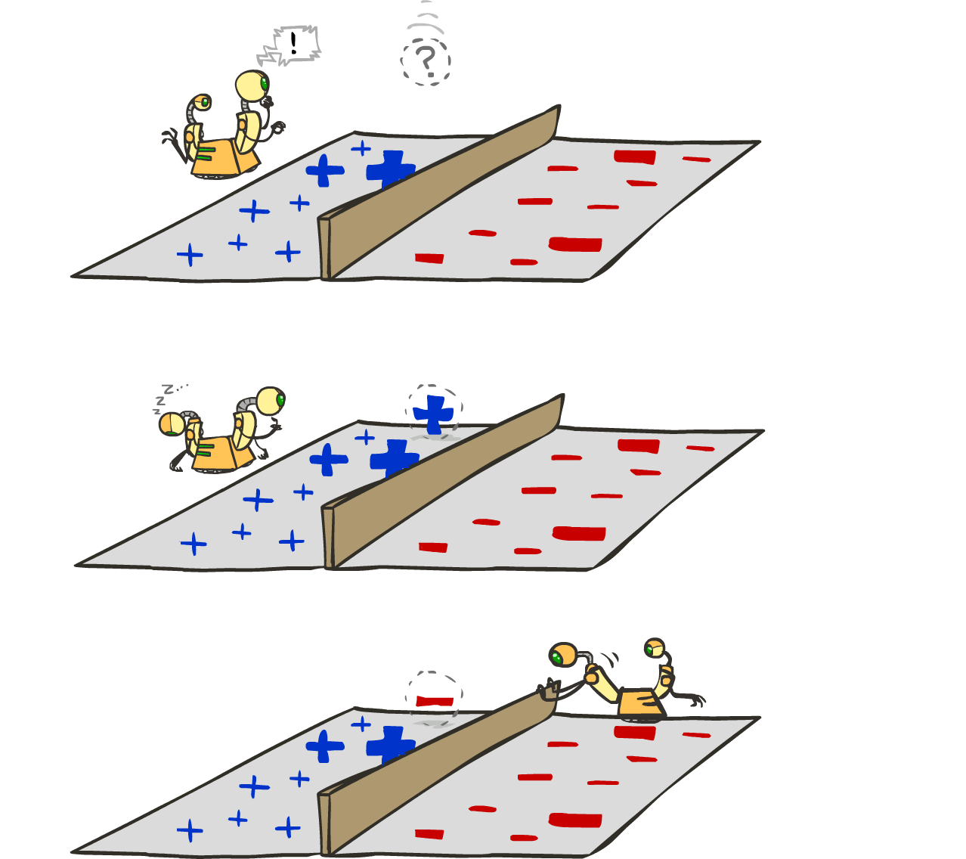
Learning: Binary Perceptron
Start with weights = 0
For each training instance:
Classify with current weights
If correct (i.e., y=y*), no change!
If wrong: adjust the weight vector
Notes:
http://isl.ira.uka.de/neuralNetCourse/2004/VL_11_5/Perceptron.html

Slide 8
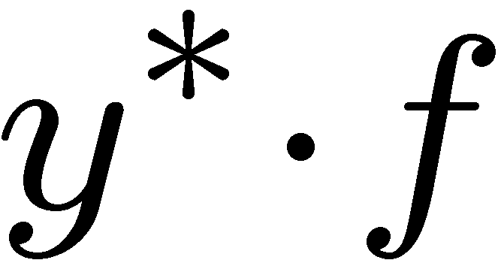
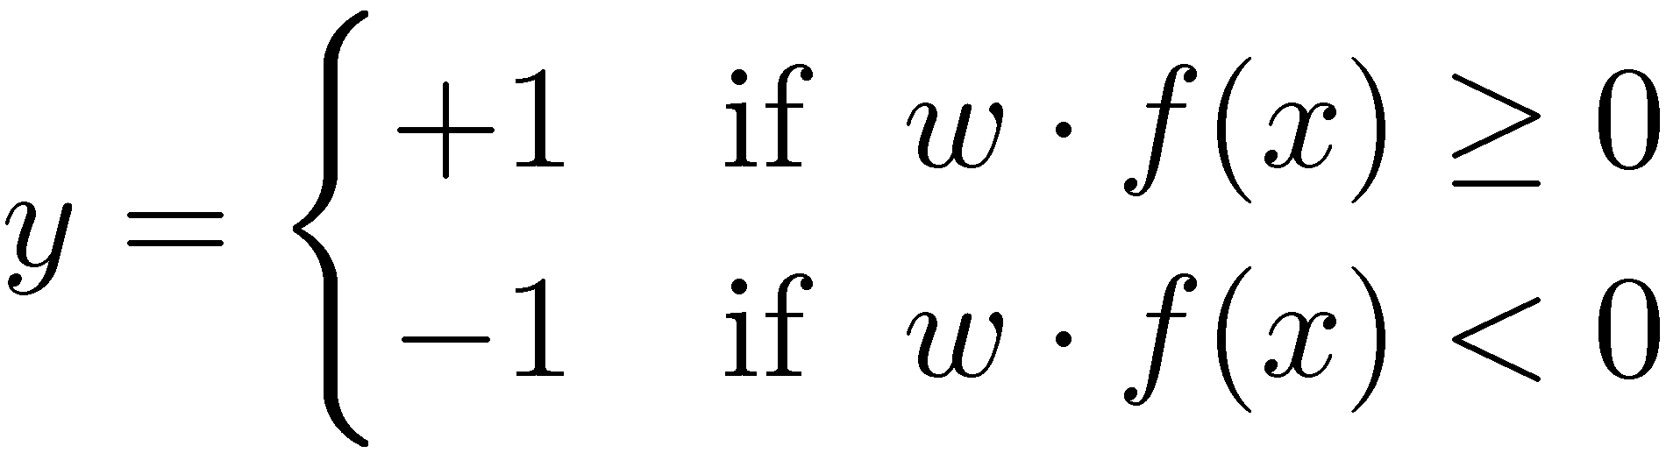

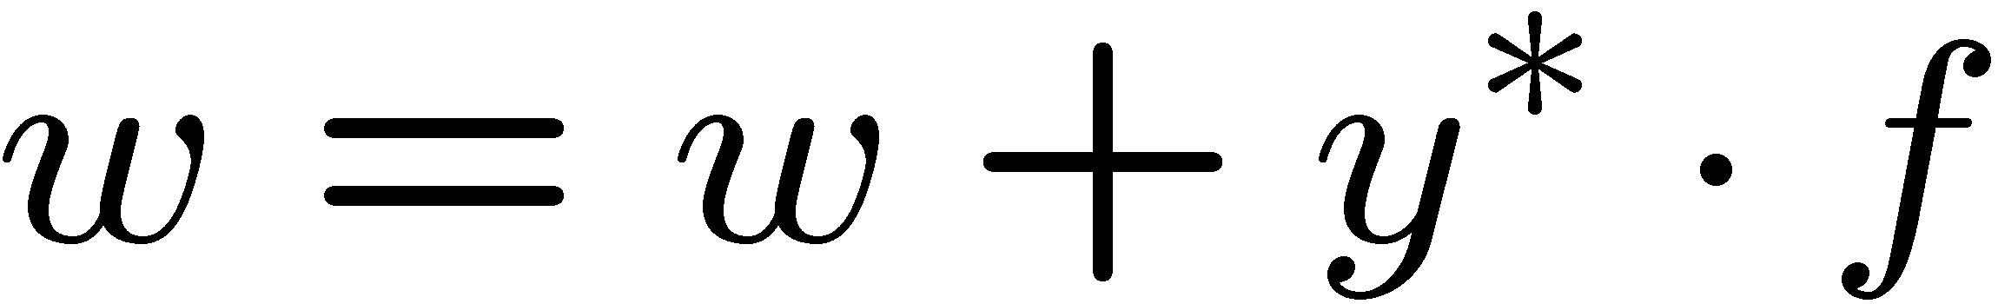
Learning: Binary Perceptron
Start with weights = 0
For each training instance:
Classify with current weights
If correct (i.e., y=y*), no change!
If wrong: adjust the weight vector by adding or subtracting the feature vector. Subtract if y* is -1.
Notes:
http://isl.ira.uka.de/neuralNetCourse/2004/VL_11_5/Perceptron.html

Slide 9
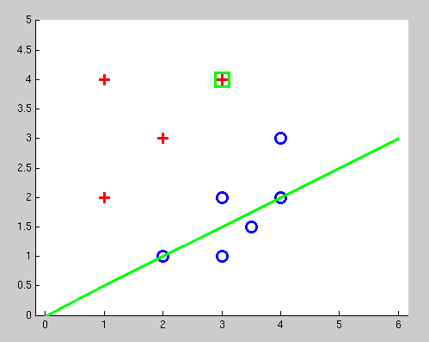
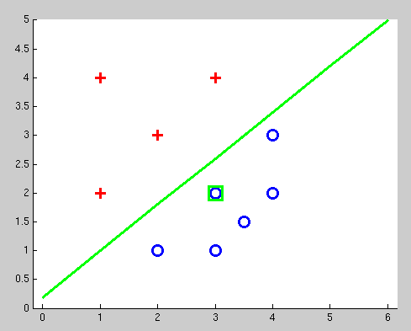
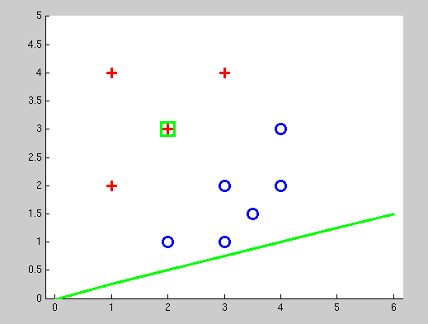
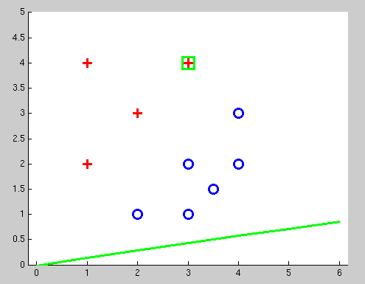
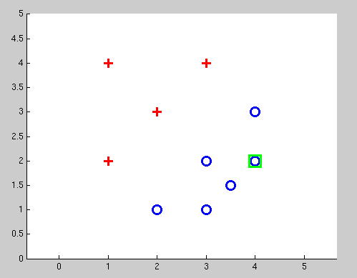
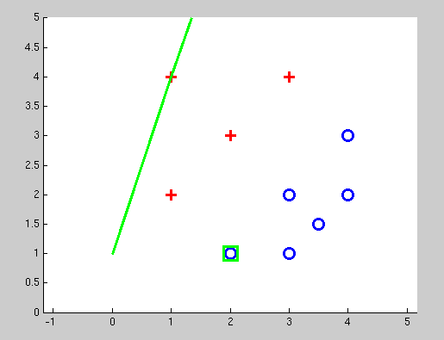
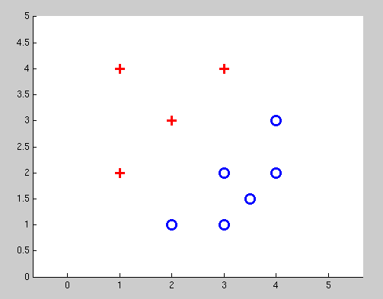
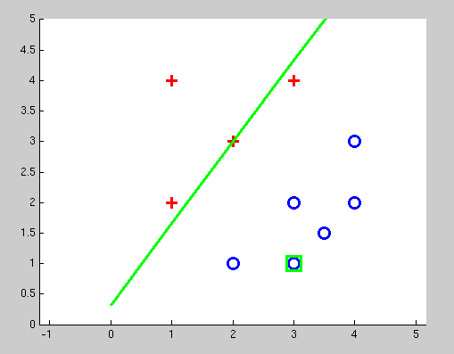
Examples: Perceptron
Separable Case

Slide 10
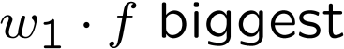




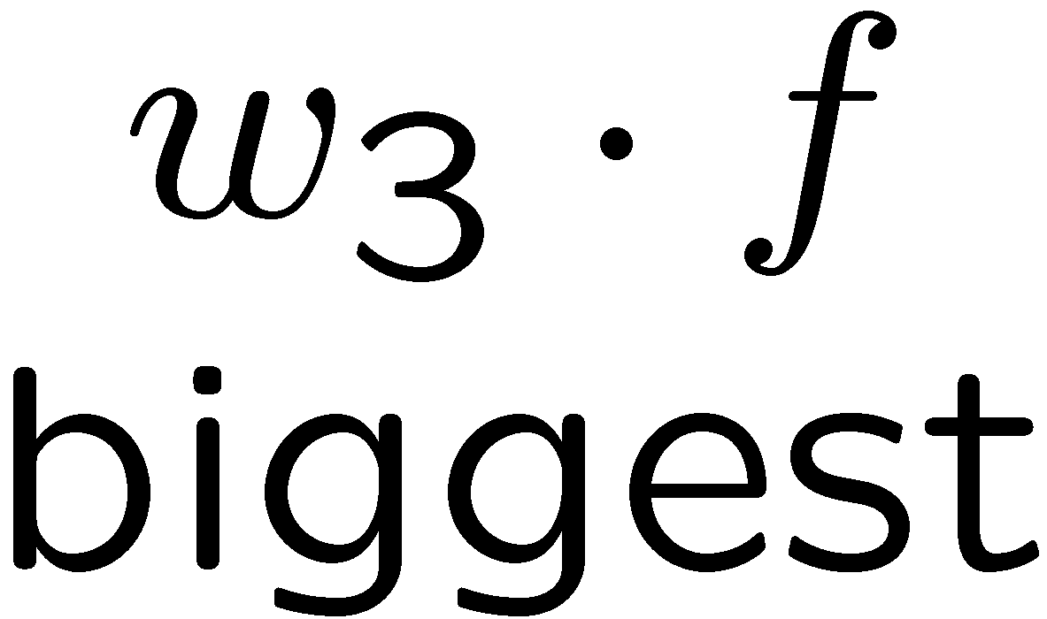
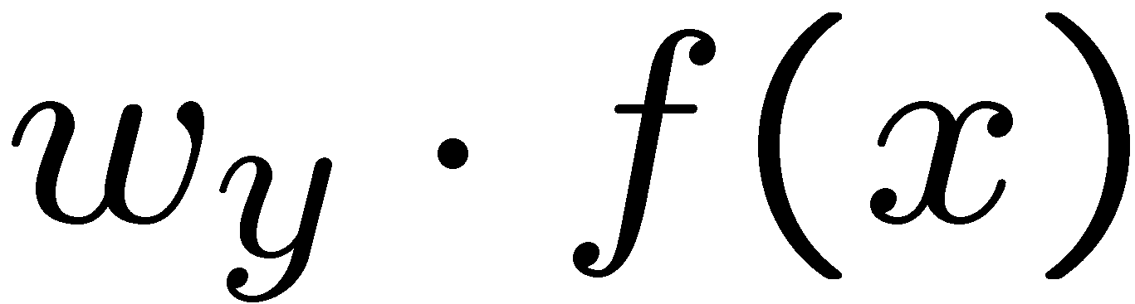
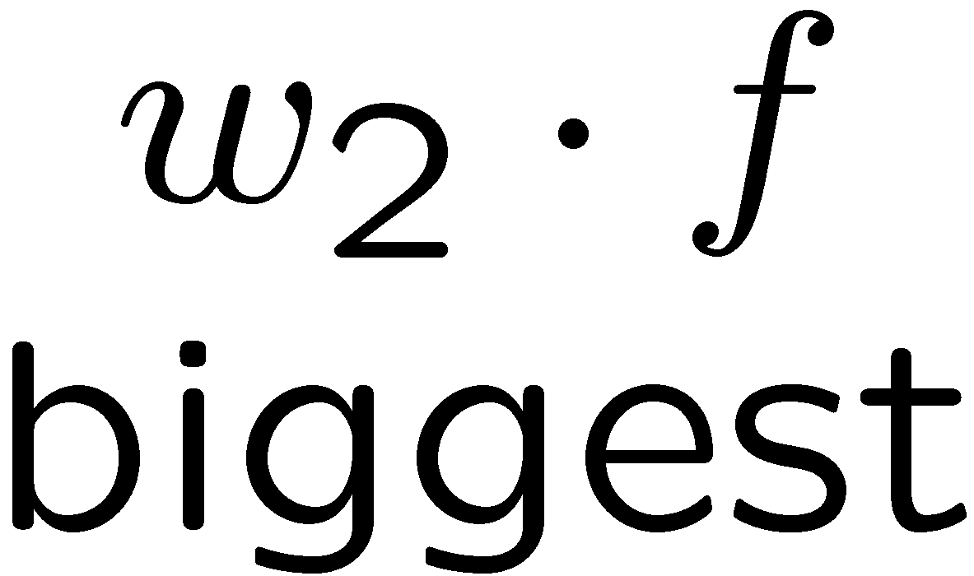
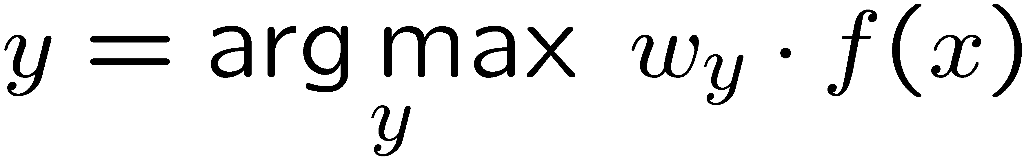
Multiclass Decision Rule
If we have multiple classes:
A weight vector for each class:
Score (activation) of a class y:
Prediction highest score wins
Binary = multiclass where the negative class has weight zero

Slide 11



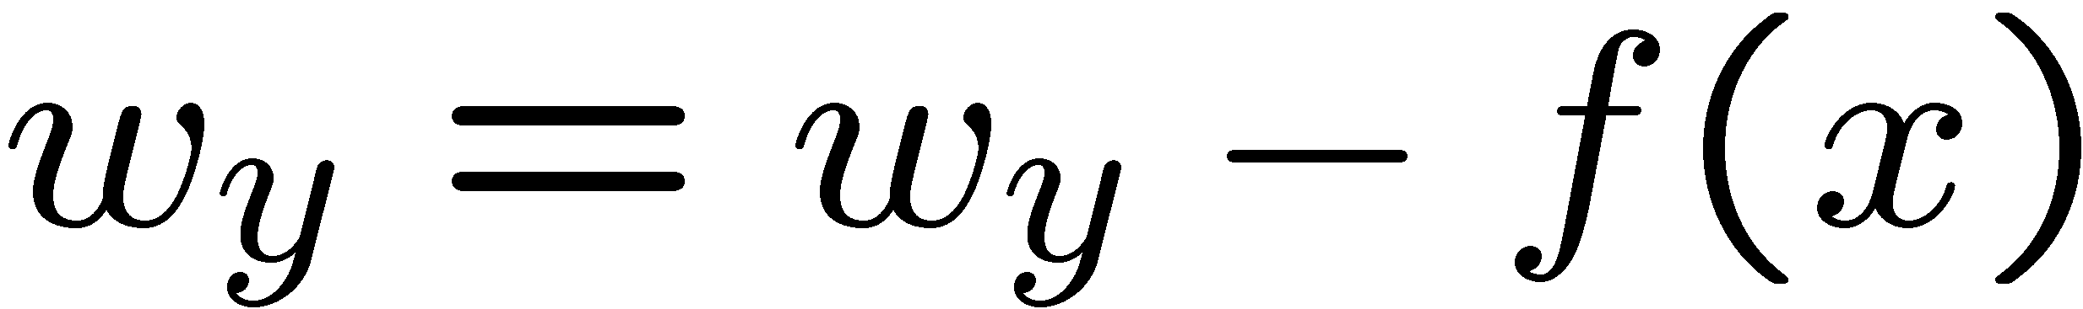
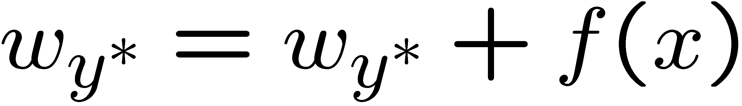
Learning: Multiclass Perceptron
Start with all weights = 0
Pick up training examples one by one
Predict with current weights
If correct, no change!
If wrong: lower score of wrong answer, raise score of right answer

Slide 12
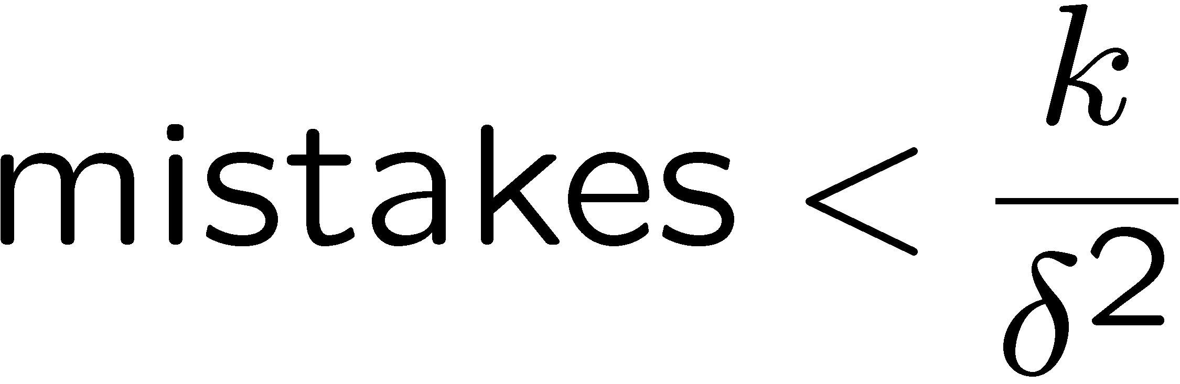
Properties of Perceptrons
Separable
Separability: true if some parameters get the training set perfectly correct
Convergence: if the training is separable, perceptron will eventually converge (binary case)
Mistake Bound: the maximum number of mistakes (binary case) related to the margin or degree of separability
Non-Separable

Slide 13





Problems with the Perceptron
Noise: if the data isn’t separable, weights might thrash
Averaging weight vectors over time can help (averaged perceptron)
Mediocre generalization: finds a “barely” separating solution
Overtraining: test / held-out accuracy usually rises, then falls
Overtraining is a kind of overfitting

Slide 14
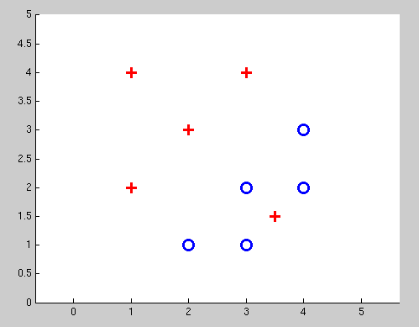
Non-Separable Case: Deterministic Decision
Even the best linear boundary makes at least one mistake

Slide 15
Non-Separable Case: Probabilistic Decision
0.9 | 0.1
0.7 | 0.3
0.5 | 0.5
0.3 | 0.7
0.1 | 0.9

Slide 16
How to get probabilistic decisions?
Perceptron scoring:
If very positive → want probability going to 1
If very negative → want probability going to 0
Sigmoid function

Slide 17
Best w?
Maximum likelihood estimation:
with:
= Logistic Regression

Slide 18
Separable Case: Deterministic Decision – Many Options

Slide 19
Separable Case: Probabilistic Decision – Clear Preference
0.7 | 0.3
0.5 | 0.5
0.7 | 0.3
0.3 | 0.7
0.5 | 0.5
0.3 | 0.7

Slide 20
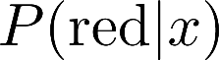


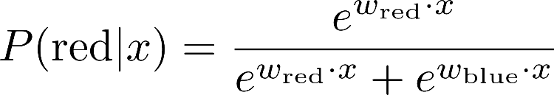
A 1D Example
definitely blue
not sure
definitely red
probability increases exponentially as we move away from boundary
normalizer

Slide 21
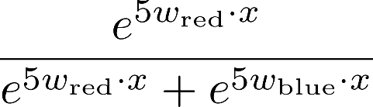
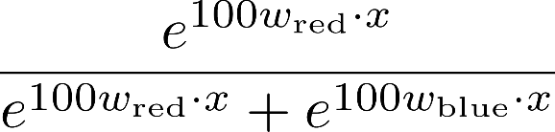
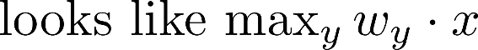
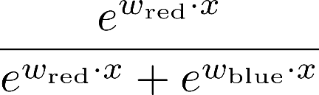
The Soft Max

Slide 22
Multiclass Logistic Regression
Recall Perceptron:
A weight vector for each class:
Score (activation) of a class y:
Prediction highest score wins
How to make the scores into probabilities?
original activations
softmax activations

Slide 23
Best w?
Maximum likelihood estimation:
with:
= Multi-Class Logistic Regression

Slide 24
Optimization
i.e., how do we solve:

Slide 25
Hill Climbing
General idea
Start wherever
Repeat: move to the best neighboring state
If no neighbors better than current, quit
What’s particularly tricky when hill-climbing for multiclass logistic regression?
Optimization over a continuous space
Infinitely many neighbors!
How to do this efficiently?

Slide 26
1-D Optimization
Could evaluate and
Then step in best direction
Or, evaluate derivative:
Tells which direction to step into

Slide 27
2-D Optimization
Source: offconvex.org

Slide 28
Gradient Ascent
Perform update in uphill direction for each coordinate
The steeper the slope (i.e. the higher the derivative) the bigger the step for that coordinate
E.g., consider:
Updates:
Updates in vector notation:
with:
= gradient

Slide 29
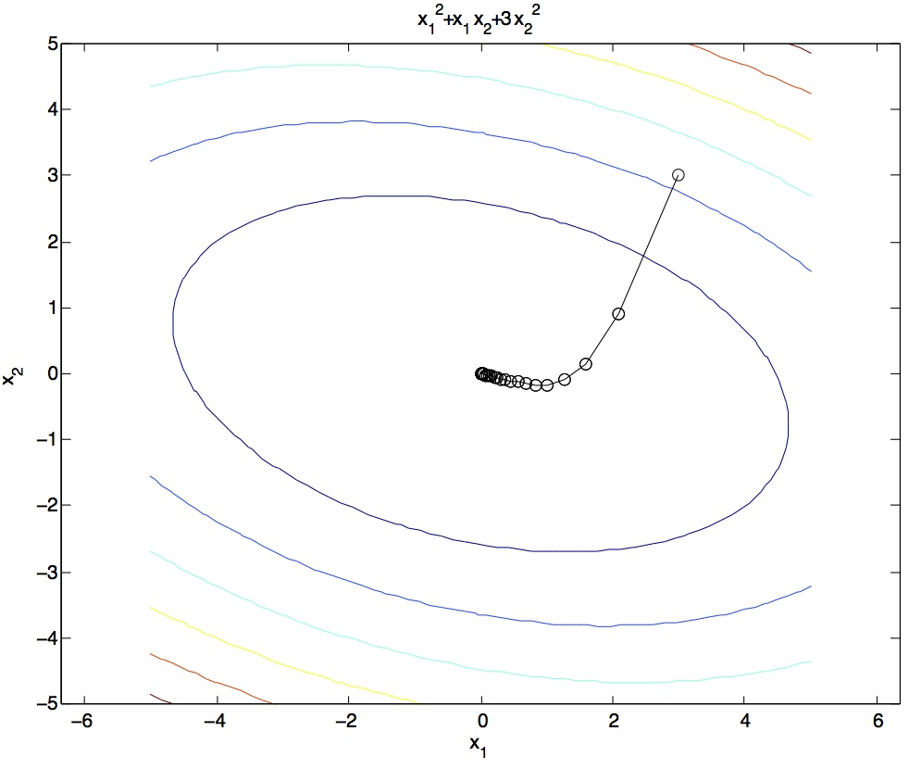
Gradient Ascent
Idea:
Start somewhere
Repeat: Take a step in the gradient direction
Figure source: Mathworks

Slide 30
What is the Steepest Direction?
First-Order Taylor Expansion:
Steepest Ascent Direction:
Recall: →
Hence, solution:
Gradient direction = steepest direction!

Slide 31
Gradient in n dimensions

Slide 32
Optimization Procedure: Gradient Ascent
init
for iter = 1, 2, …
: learning rate --- tweaking parameter that needs to be chosen carefully
How? Try multiple choices
Crude rule of thumb: update changes about 0.1 – 1 %

Slide 33
Batch Gradient Ascent on the Log Likelihood Objective
init
for iter = 1, 2, …

Slide 34
What will gradient ascent do?
adds f to the correct class weights
for y’ weights:
subtracts f from y’ weights in proportion to the probability current weights give to y’

Slide 35
Stochastic Gradient Ascent on the Log Likelihood Objective
Observation: once gradient on one training example has been computed, might as well incorporate before computing next one
init
for iter = 1, 2, …
pick random j

Slide 36
Mini-Batch Gradient Ascent on the Log Likelihood Objective
Observation: gradient over small set of training examples (=mini-batch) can be computed in parallel, might as well do that instead of a single one
init
for iter = 1, 2, …
pick random subset of training examples J

Slide 37
Multi-class Logistic Regression
= special case of neural network
f₁(x)
z₁
softmax
f₂(x)
z₂
f₃(x)
…
z₃
f_{K}(x)

Slide 38
Deep Neural Network = Also learn the features!
f₁(x)
z₁
softmax
f₂(x)
z₂
f₃(x)
…
z₃
f_{K}(x)

Slide 39
Deep Neural Network = Also learn the features!
x₁
f₁(x)
softmax
x₂
f₂(x)
…
x₃
f₃(x)
…
…
…
…
…
x_{L}
f_{K}(x)
g = nonlinear activation function

Slide 40
Deep Neural Network = Also learn the features!
x₁
softmax
x₂
…
x₃
…
…
…
…
…
x_{L}
g = nonlinear activation function

Slide 41
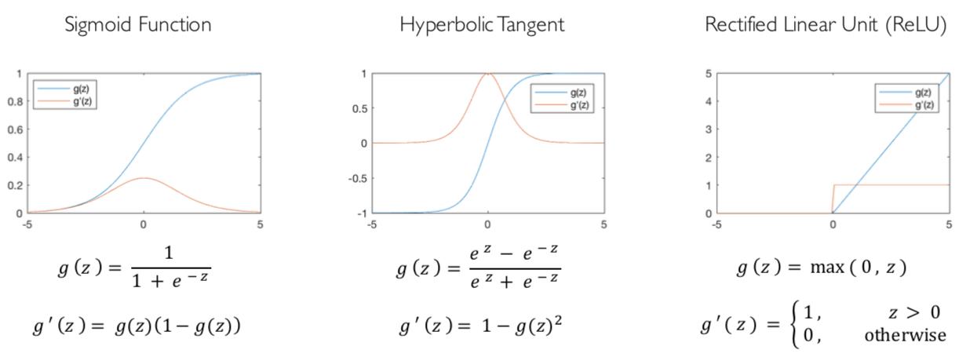
Common Activation Functions
[source: MIT 6.S191 introtodeeplearning.com]

Slide 42
Deep Neural Network: Also Learn the Features!
Training the deep neural network is just like logistic regression:
just w tends to be a much, much larger vector ☺
just run gradient ascent
+ stop when log likelihood of hold-out data starts to decrease

Slide 43
Neural Networks Properties
Theorem (Universal Function Approximators). A two-layer neural network with a sufficient number of neurons can approximate any continuous function to any desired accuracy.
Practical considerations
Can be seen as learning the features
Large number of neurons
Danger for overfitting
(hence early stopping!)

Slide 44
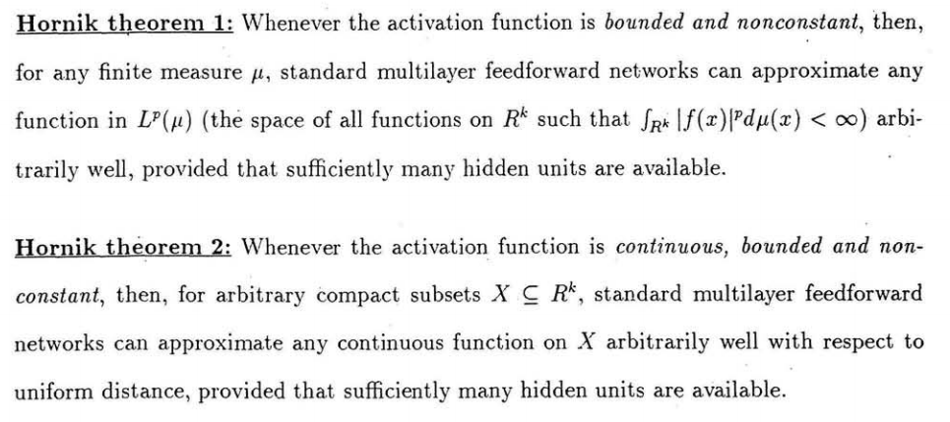
Universal Function Approximation Theorem*
In words: Given any continuous function f(x), if a 2-layer neural network has enough hidden units, then there is a choice of weights that allow it to closely approximate f(x).
Cybenko (1989) “Approximations by superpositions of sigmoidal functions”
Hornik (1991) “Approximation Capabilities of Multilayer Feedforward Networks”
Leshno and Schocken (1991) ”Multilayer Feedforward Networks with Non-Polynomial Activation Functions Can Approximate Any Function”

Slide 45
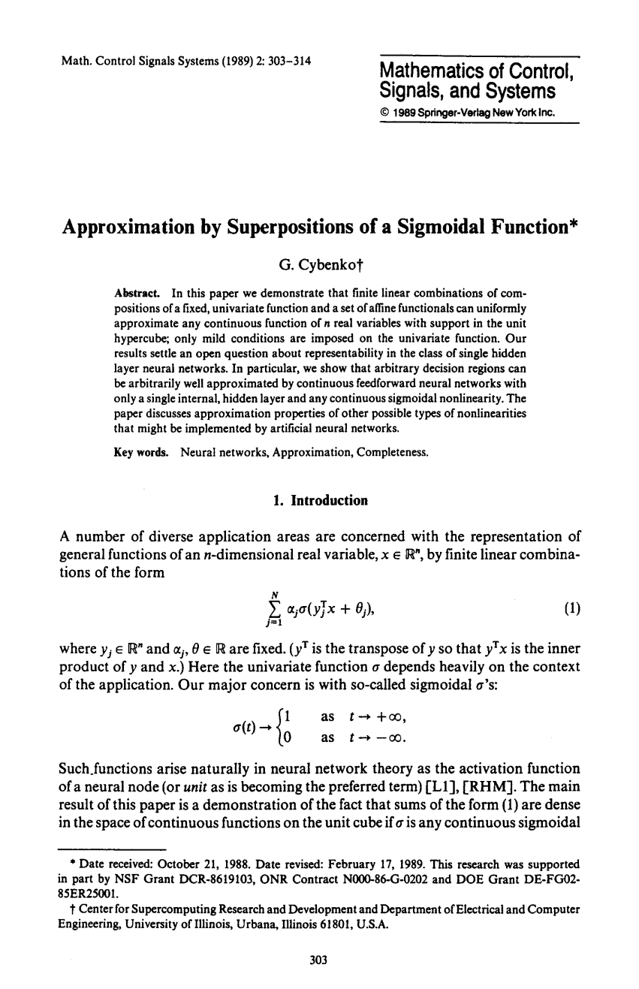
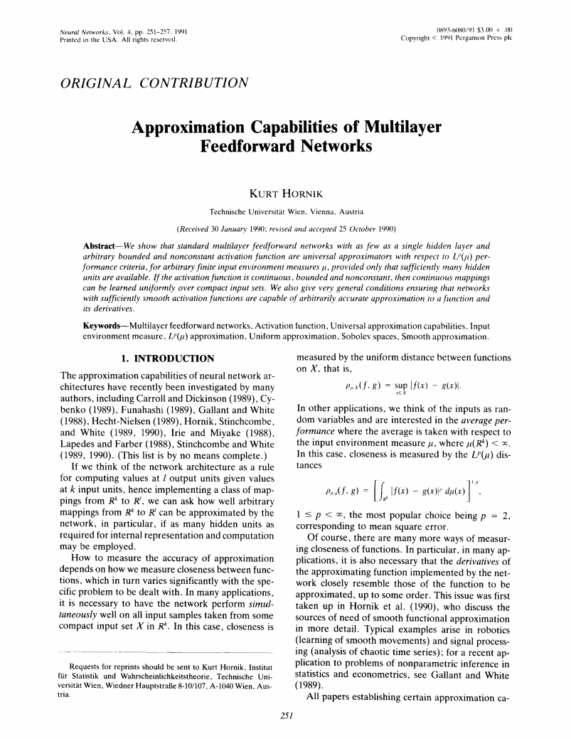
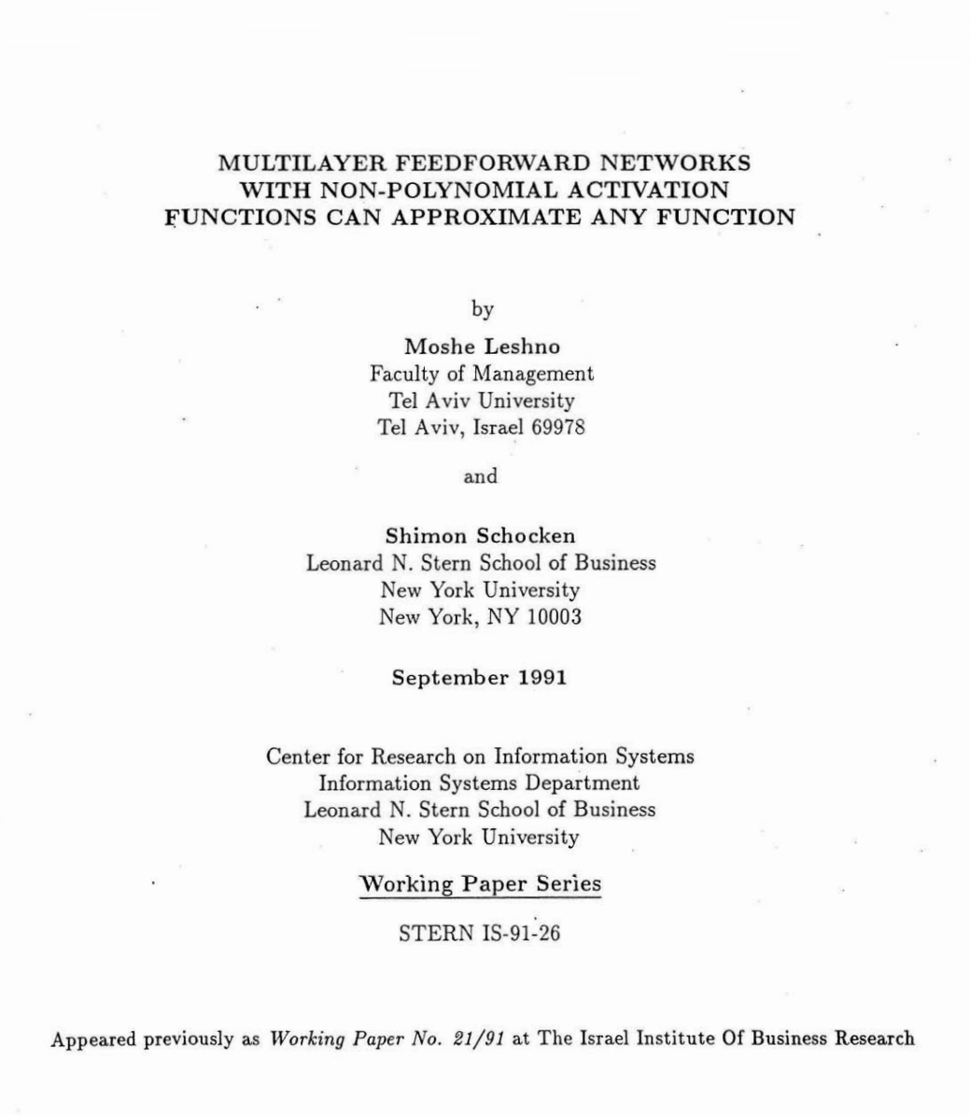
Universal Function Approximation Theorem*
Cybenko (1989) “Approximations by superpositions of sigmoidal functions”
Hornik (1991) “Approximation Capabilities of Multilayer Feedforward Networks”
Leshno and Schocken (1991) ”Multilayer Feedforward Networks with Non-Polynomial Activation Functions Can Approximate Any Function”

Slide 46
How about computing all the derivatives?
Derivatives tables:
[source: http://hyperphysics.phy-astr.gsu.edu/hbase/Math/derfunc.html

Slide 47
How about computing all the derivatives?
But neural net f is never one of those?
No problem: CHAIN RULE:
If
Then
→ Derivatives can be computed by following well-defined procedures

Slide 48
Automatic Differentiation
Automatic differentiation software
e.g. PyTorch, TensorFlow, JAX
Only need to program the function g(x,y,w)
Can automatically compute all derivatives w.r.t. all entries in w
This is typically done by caching info during forward computation pass of f, and then doing a backward pass = “backpropagation”
Autodiff / Backpropagation can often be done at computational cost comparable to the forward pass

Slide 49
Training a Network (setting weights)
x₁
softmax
x₂
…
x₃
…
…
…
…
…
x_{L}
g = nonlinear activation function

Slide 50
Training a Network
softmax
Key words:
Forward
Backwards
Gradient
Backprop
…
…
g = nonlinear activation function

Slide 51
Back Propagation: $g\left(w\right)=w_{1}^{3}w_{2}+3w_{1}$
Suppose we have $g\left(w\right)=w_{1}^{3}w_{2}+3w_{1}$ and want the gradient at $w=[2, 3]$
Think of the function as a composition of many functions.
Can use derivative chain rule to compute $∂g/∂w_{1}$ and $∂g/∂w_{2}$.
$g=b+c$
$\frac{∂g}{∂b}=1$, $\frac{∂g}{∂c}=1$
2
$∎^{3}$
$$a=8$$
$$w_{1}$$
$×$
$$b=24$$
3
$$\frac{∂g}{∂b}=1$$
$$w_{2}$$
$$g=30$$
$+$
$$1$$
$$3$$
$×$
$$c=6$$
$$w_{1}$$
2
$$\frac{∂g}{∂c}=1$$
$$\frac{∂g}{∂g}=1$$

Slide 52
Back Propagation: $g\left(w\right)=w_{1}^{3}w_{2}+3w_{1}$
Suppose we have $g\left(w\right)=w_{1}^{3}w_{2}+3w_{1}$ and want the gradient at $w=[2, 3]$
Think of the function as a composition of many functions.
Can use derivative chain rule to compute $∂g/∂w_{1}$ and $∂g/∂w_{2}$.
$g=b+c$
$\frac{∂g}{∂b}=1$, $\frac{∂g}{∂c}=1$
$b=a×w_{2}$
$\frac{∂g}{∂a}=\frac{∂g}{∂b}\frac{∂b}{∂a}$
2
$∎^{3}$
$$a=8$$
$$w_{1}$$
$×$
$$b=24$$
3
$$\frac{∂g}{∂b}=1$$
$$w_{2}$$
$$g=30$$
$+$
$$1$$
$$3$$
$×$
$$c=6$$
$$w_{1}$$
2
$$\frac{∂g}{∂c}=1$$
$$\frac{∂g}{∂g}=1$$

Slide 53
Back Propagation: $g\left(w\right)=w_{1}^{3}w_{2}+3w_{1}$
Suppose we have $g\left(w\right)=w_{1}^{3}w_{2}+3w_{1}$ and want the gradient at $w=[2, 3]$
Think of the function as a composition of many functions.
Can use derivative chain rule to compute $∂g/∂w_{1}$ and $∂g/∂w_{2}$.
$g=b+c$
$\frac{∂g}{∂b}=1$, $\frac{∂g}{∂c}=1$
$b=a×w_{2}$
$\frac{∂g}{∂a}=\frac{∂g}{∂b}\frac{∂b}{∂a}=?????$
2
$∎^{3}$
$$a=8$$
$$w_{1}$$
$×$
$$b=24$$
3
$$\frac{∂g}{∂b}=1$$
$$w_{2}$$
$$g=30$$
$+$
$$1$$
$$3$$
$×$
$$c=6$$
$$w_{1}$$
2
$$\frac{∂g}{∂c}=1$$
$$\frac{∂g}{∂g}=1$$

Slide 54
Back Propagation: $g\left(w\right)=w_{1}^{3}w_{2}+3w_{1}$
Suppose we have $g\left(w\right)=w_{1}^{3}w_{2}+3w_{1}$ and want the gradient at $w=[2, 3]$
Think of the function as a composition of many functions.
Can use derivative chain rule to compute $∂g/∂w_{1}$ and $∂g/∂w_{2}$.
$g=b+c$
$\frac{∂g}{∂b}=1$, $\frac{∂g}{∂c}=1$
$b=a×w_{2}$
$\frac{∂g}{∂a}=\frac{∂g}{∂b}\frac{∂b}{∂a}=1\frac{∂b}{∂a}=1⋅3=3$
2
$∎^{3}$
$$a=8$$
$$w_{1}$$
$$3$$
$×$
$$b=24$$
3
$$\frac{∂g}{∂b}=1$$
$$w_{2}$$
$$g=30$$
$+$
$$1$$
$$3$$
$×$
$$c=6$$
$$w_{1}$$
2
$$\frac{∂g}{∂c}=1$$
$$\frac{∂g}{∂g}=1$$

Slide 55
Back Propagation: $g\left(w\right)=w_{1}^{3}w_{2}+3w_{1}$
Suppose we have $g\left(w\right)=w_{1}^{3}w_{2}+3w_{1}$ and want the gradient at $w=[2, 3]$
Think of the function as a composition of many functions.
Can use derivative chain rule to compute $∂g/∂w_{1}$ and $∂g/∂w_{2}$.
$g=b+c$
$\frac{∂g}{∂b}=1$, $\frac{∂g}{∂c}=1$
$b=a×w_{2}$
$\frac{∂g}{∂a}=\frac{∂g}{∂b}\frac{∂b}{∂a}=1\frac{∂b}{∂a}=1⋅3=3$
$a=w_{1}^{3}$
$\frac{∂g}{∂w_{1}}=?????$
2
$∎^{3}$
$$a=8$$
$$w_{1}$$
$$3$$
$×$
$$b=24$$
3
$$\frac{∂g}{∂b}=1$$
$$w_{2}$$
$$g=30$$
$+$
$$1$$
$$3$$
$×$
$$c=6$$
$$w_{1}$$
2
$$\frac{∂g}{∂c}=1$$
$$\frac{∂g}{∂g}=1$$

Slide 56
Back Propagation: $g\left(w\right)=w_{1}^{3}w_{2}+3w_{1}$
Suppose we have $g\left(w\right)=w_{1}^{3}w_{2}+3w_{1}$ and want the gradient at $w=[2, 3]$
Think of the function as a composition of many functions.
Can use derivative chain rule to compute $∂g/∂w_{1}$ and $∂g/∂w_{2}$.
$g=b+c$
$\frac{∂g}{∂b}=1$, $\frac{∂g}{∂c}=1$
$b=a×w_{2}$
$\frac{∂g}{∂a}=\frac{∂g}{∂b}\frac{∂b}{∂a}=1\frac{∂b}{∂a}=1⋅3=3$
$a=w_{1}^{3}$
$\frac{∂g}{∂w_{1}}=\frac{∂g}{∂a}\frac{∂a}{∂w_{1}}=3⋅3w_{1}^{2}=36$
2
$∎^{3}$
$$a=8$$
$$w_{1}$$
$$36$$
$$3$$
$×$
$$b=24$$
3
$$\frac{∂g}{∂b}=1$$
$$w_{2}$$
$$g=30$$
$+$
$$1$$
$$3$$
$×$
$$c=6$$
$$w_{1}$$
2
$$\frac{∂g}{∂c}=1$$
$$\frac{∂g}{∂g}=1$$
Interpretation: A tiny increase in $w_{1}$ will result in an approximately $36w_{1}$ increase in g due to this cube function.

Slide 57
Back Propagation: $g\left(w\right)=w_{1}^{3}w_{2}+3w_{1}$
Suppose we have $g\left(w\right)=w_{1}^{3}w_{2}+3w_{1}$ and want the gradient at $w=[2, 3]$
Think of the function as a composition of many functions.
Can use derivative chain rule to compute $∂g/∂w_{1}$ and $∂g/∂w_{2}$.
$g=b+c$
$\frac{∂g}{∂b}=1$, $\frac{∂g}{∂c}=1$
$b=a×w_{2}$
$\frac{∂g}{∂a}=\frac{∂g}{∂b}\frac{∂b}{∂a}=1\frac{∂b}{∂a}=1⋅3=3$
$a=w_{1}^{3}$
$\frac{∂g}{∂w_{1}}=\frac{∂g}{∂a}\frac{∂a}{∂w_{1}}=3⋅3w_{1}^{2}=36$
$\frac{∂g}{∂w_{2}}=???$
2
$∎^{3}$
$$a=8$$
$$w_{1}$$
$$36$$
$$3$$
$×$
$$b=24$$
3
$$\frac{∂g}{∂b}=1$$
$$w_{2}$$
$$g=30$$
$+$
$$1$$
$$3$$
$×$
$$c=6$$
$$w_{1}$$
2
$$\frac{∂g}{∂c}=1$$
$$\frac{∂g}{∂g}=1$$
Hint: $b=a×3$ may be useful.

Slide 58
Back Propagation: $g\left(w\right)=w_{1}^{3}w_{2}+3w_{1}$
Suppose we have $g\left(w\right)=w_{1}^{3}w_{2}+3w_{1}$ and want the gradient at $w=[2, 3]$
Think of the function as a composition of many functions.
Can use derivative chain rule to compute $∂g/∂w_{1}$ and $∂g/∂w_{2}$.
$g=b+c$
$\frac{∂g}{∂b}=1$, $\frac{∂g}{∂c}=1$
$b=a×w_{2}$
$\frac{∂g}{∂a}=\frac{∂g}{∂b}\frac{∂b}{∂a}=1\frac{∂b}{∂a}=1⋅3=3$
$\frac{∂g}{∂w_{2}}=\frac{∂g}{∂b}\frac{∂b}{∂w_{2}}=1\frac{∂b}{∂w_{2}}=1⋅8=8$
$a=w_{1}^{3}$
$\frac{∂g}{∂w_{1}}=\frac{∂g}{∂a}\frac{∂a}{∂w_{1}}=3⋅3w_{1}^{2}=36$
2
$∎^{3}$
$$a=8$$
$$w_{1}$$
$$36$$
$$3$$
$×$
$$b=24$$
3
$$\frac{∂g}{∂b}=1$$
$$w_{2}$$
$$g=30$$
$$8$$
$+$
$$1$$
$$3$$
$×$
$$c=6$$
$$w_{1}$$
2
$$\frac{∂g}{∂c}=1$$
$$\frac{∂g}{∂g}=1$$

Slide 59
Back Propagation: $g\left(w\right)=w_{1}^{3}w_{2}+3w_{1}$
Suppose we have $g\left(w\right)=w_{1}^{3}w_{2}+3w_{1}$ and want the gradient at $w=[2, 3]$
Think of the function as a composition of many functions, use chain rule.
$g=b+c$
$\frac{∂g}{∂b}=1$, $\frac{∂g}{∂c}=1$
$b=a×w_{2}$
$\frac{∂g}{∂a}=\frac{∂g}{∂b}\frac{∂b}{∂a}=1\frac{∂b}{∂a}=1⋅3=3$
$\frac{∂g}{∂w_{2}}=\frac{∂g}{∂b}\frac{∂b}{∂w_{2}}=1\frac{∂b}{∂w_{2}}=1⋅8=8$
$a=w_{1}^{3}$
$\frac{∂g}{∂w_{1}}=\frac{∂g}{∂a}\frac{∂a}{∂w_{1}}=3⋅3w_{1}^{2}=36$
$c=3w_{1}$
$\frac{∂g}{∂w_{1}}=\frac{∂g}{∂c}\frac{∂c}{∂w_{1}}=1⋅3=3$
2
$∎^{3}$
$$a=8$$
$$w_{1}$$
$$36$$
$$3$$
$×$
$$b=24$$
3
$$\frac{∂g}{∂b}=1$$
$$w_{2}$$
$$g=30$$
$$8$$
$+$
$$1$$
$$3$$
$×$
$$c=6$$
$$w_{1}$$
2
$$3$$
$$\frac{∂g}{∂c}=1$$
$$\frac{∂g}{∂g}=1$$
How do we reconcile this seeming contradiction?
Top partial derivative means cube function contributes $36w_{1}$ and bottom p.d. means product contributes $3w_{1}$ so add them.

Slide 60
Back Propagation: $g\left(w\right)=w_{1}^{3}w_{2}+3w_{1}$
Suppose we have $g\left(w\right)=w_{1}^{3}w_{2}+3w_{1}$ and want the gradient at $w=[2, 3]$
Think of the function as a composition of many functions, use chain rule.
$g=b+c$
$\frac{∂g}{∂b}=1$, $\frac{∂g}{∂c}=1$
$b=a×w_{2}$
$\frac{∂g}{∂a}=\frac{∂g}{∂b}\frac{∂b}{∂a}=1\frac{∂b}{∂a}=1⋅3=3$
$\frac{∂g}{∂w_{2}}=\frac{∂g}{∂b}\frac{∂b}{∂w_{2}}=1\frac{∂b}{∂w_{2}}=1⋅8=8$
$a=w_{1}^{3}$
$\frac{∂g}{∂w_{1}}=\frac{∂g}{∂a}\frac{∂a}{∂w_{1}}=3⋅3w_{1}^{2}=36$
$c=3w_{1}$
$\frac{∂g}{∂w_{1}}=\frac{∂g}{∂c}\frac{∂c}{∂w_{1}}=1⋅3=3$
2
$∎^{3}$
$$a=8$$
$$w_{1}$$
$$36$$
$$3$$
$×$
$$b=24$$
3
$$\frac{∂g}{∂b}=1$$
$$w_{2}$$
$$g=30$$
$$8$$
$+$
$$1$$
$$3$$
$×$
$$c=6$$
$$w_{1}$$
2
$$3$$
$$\frac{∂g}{∂c}=1$$
$$\frac{∂g}{∂g}=1$$
$$∇g=\left[\frac{∂g}{∂w_{1}},\frac{∂g}{∂w_{2}}\right]=[39, 8]$$

